Slide 1
Lesson 2 – Homework review

Slide 2
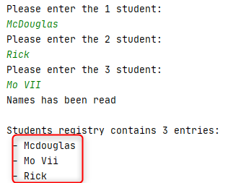
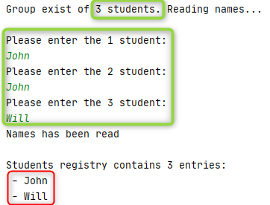
Solve the task: lost data

Slide 3
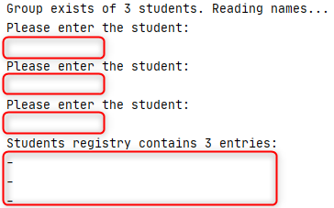




Solve the task: missing validation

Slide 4
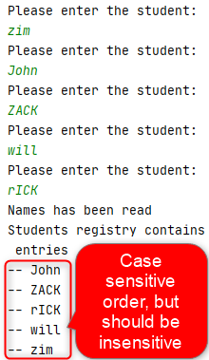
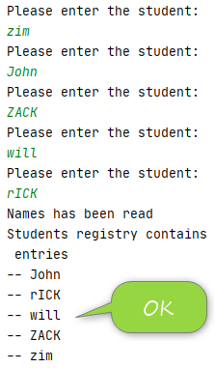
Solve the task: sorting

Slide 5






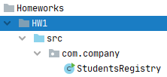
Use correct project structure

Slide 6


Program should complete successfully

Slide 7

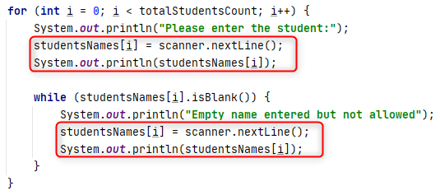
DRY – Don’t Repeat Yourself

Slide 8
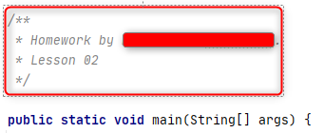
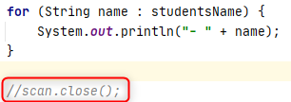

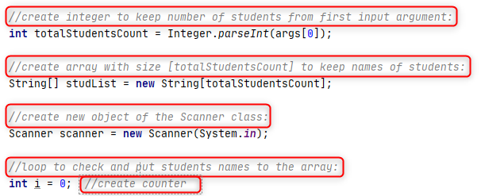
Remove useless comments

Slide 9
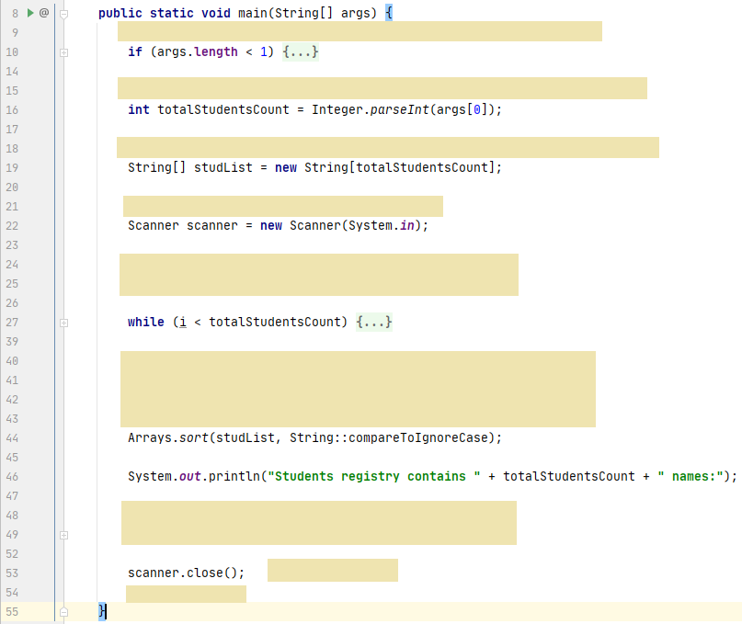
Single Responsibility
ensureStudentsCountSpecified
readStudentsFromConsole
sortStudentsCaseInsensitively
…

Slide 10
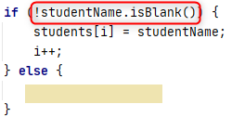
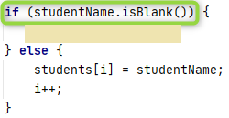
KISS - Keep It Simple Student

Slide 11



Minimize regular expressions usage

Slide 12
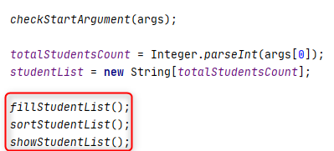

Prefer immutability

Slide 13



Avoid magic numbers

Slide 14
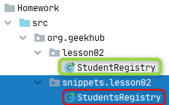

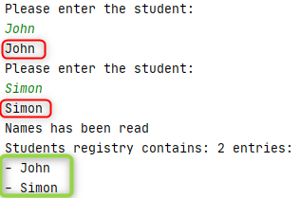

Do not do extra work

Slide 15
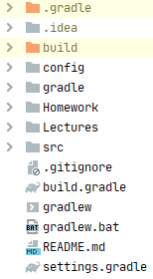

Do not do extra work

Slide 16
Git messaging

